Slide 1
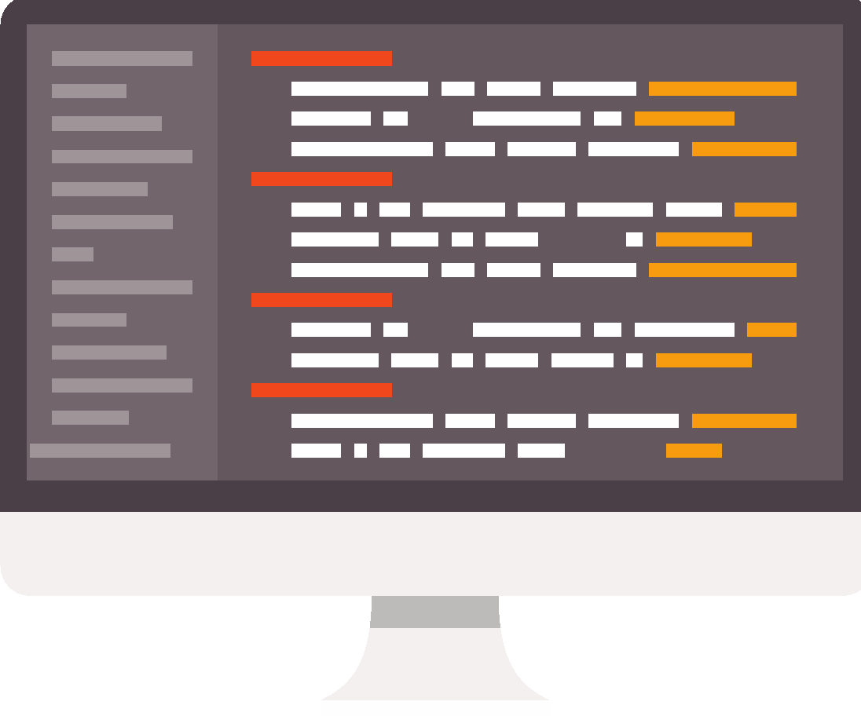
Programming in Python: sequence
Lesson 4: Placeholders and lists

Slide 2
Objectives
In this lesson, you will learn:
how to format output using placeholders
how to format input prompts using placeholders
that a list is a container for a set of variables
how to put data into a list.

Slide 3
Data
The output from a program is:
May, 23, 7, 24

Slide 4
Data and information
Data is often quite meaningless by itself.
It needs context to give it meaning.
data + context = information
If the output from the program is formatted to give it context, it has meaning:
The average weather for May in Birmingham is a temperature of 23 degrees, 7 hours of sunshine and 24 cm of rain.

Slide 5

Activity 4.1: Programming in Python: sequence, Section 4

Slide 6
Question 1
You have been learning about lists.
Look at this list:
veg=['carrot','onion','cabbage','potato','leek','parsnip','kale’]
Which vegetable would be retrieved with the following code?
veg[1]
onion
veg[0]
carrot
veg[5]
parsnip

Slide 7
Question 2
veg=['carrot','onion','cabbage','potato','leek','parsnip','kale’]
How would you retrieve the element from the list that contains the following word?
kale
cabbage

Slide 8
Question 3
veg=['carrot','onion','cabbage','potato','leek','parsnip','kale’]
What command would you use to add celery to the end of the list?

Slide 9
Quiz 4

